Slide 1
Timed Reading Quiz
Triads: 7 Mixed Major & Minor Prepared Reading; 3 Prima Vista
eNovation 4 Triads in Major and Minor Keys Treble, Bass, Alto, Tenor Clefs
Slide Timings:
Examples show for 15” / “Play now” shows for 10”
Prima Vista 22” / 12”

Slide 2
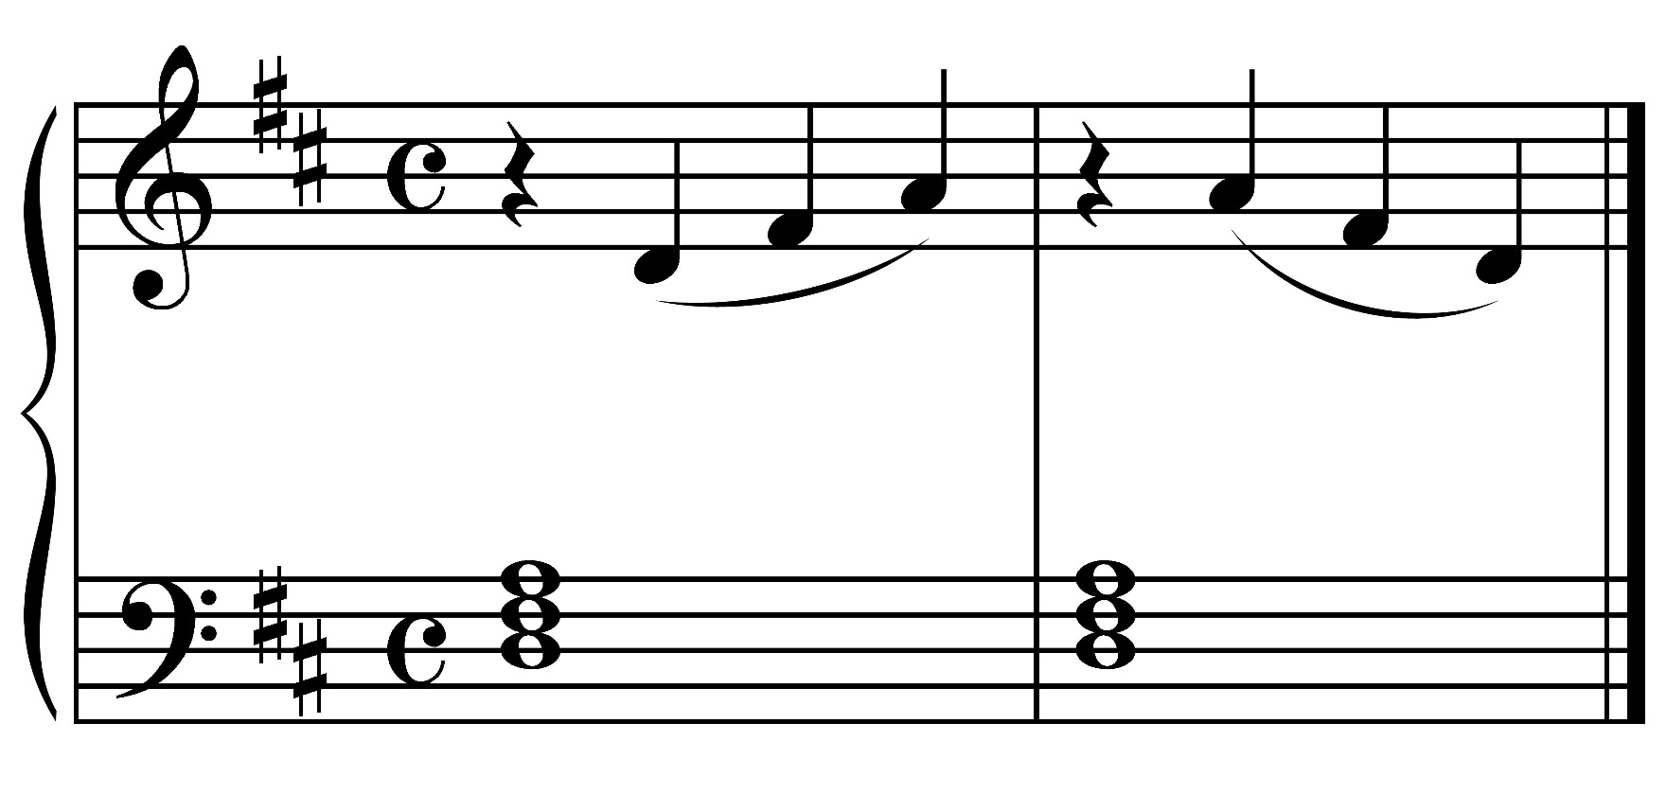
Example 1

Slide 3
Play now.

Slide 4
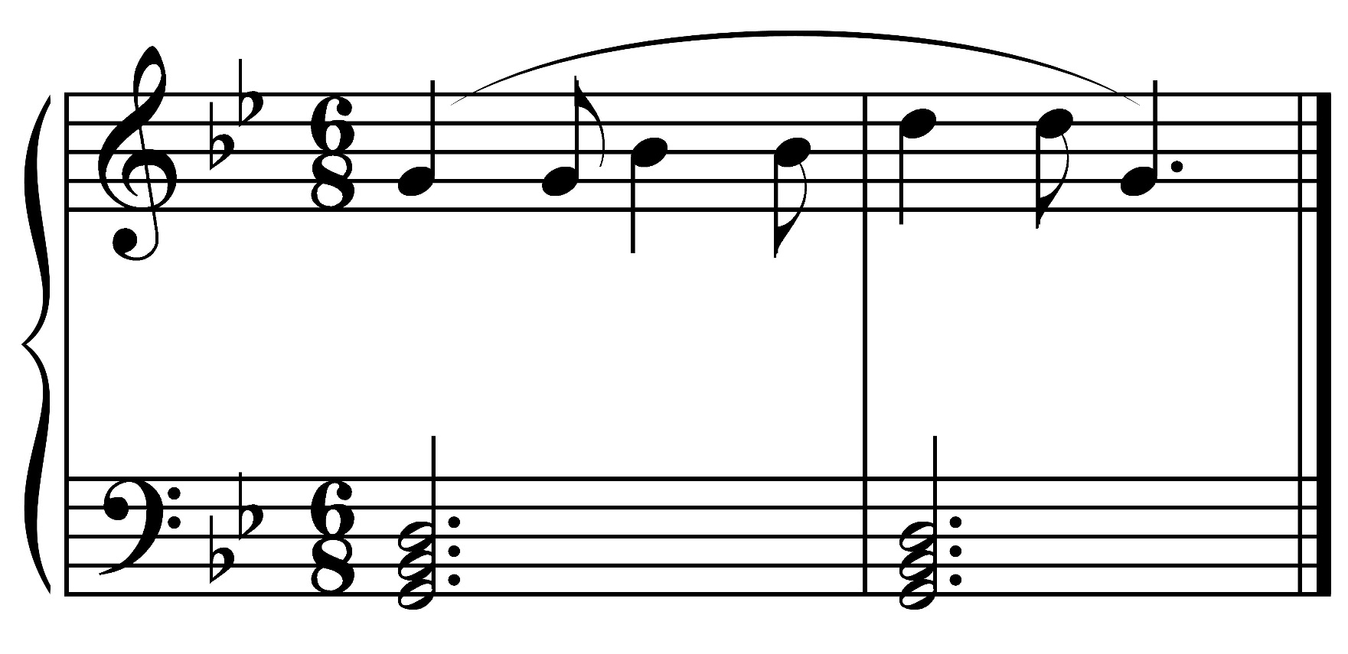
Example 2

Slide 5
Play now.

Slide 6
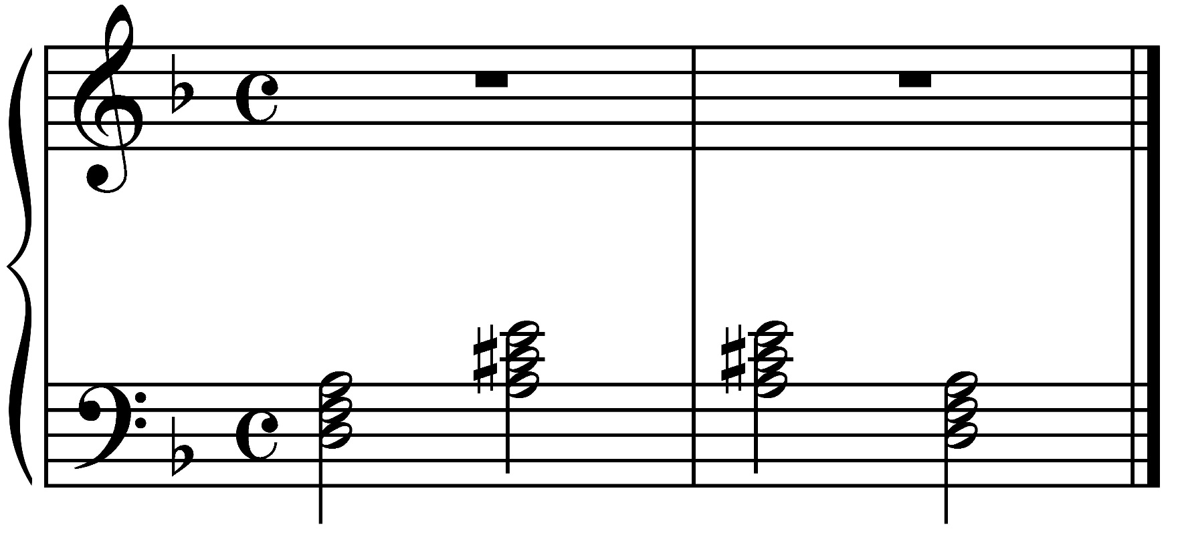
Example 3

Slide 7
Play now.

Slide 8
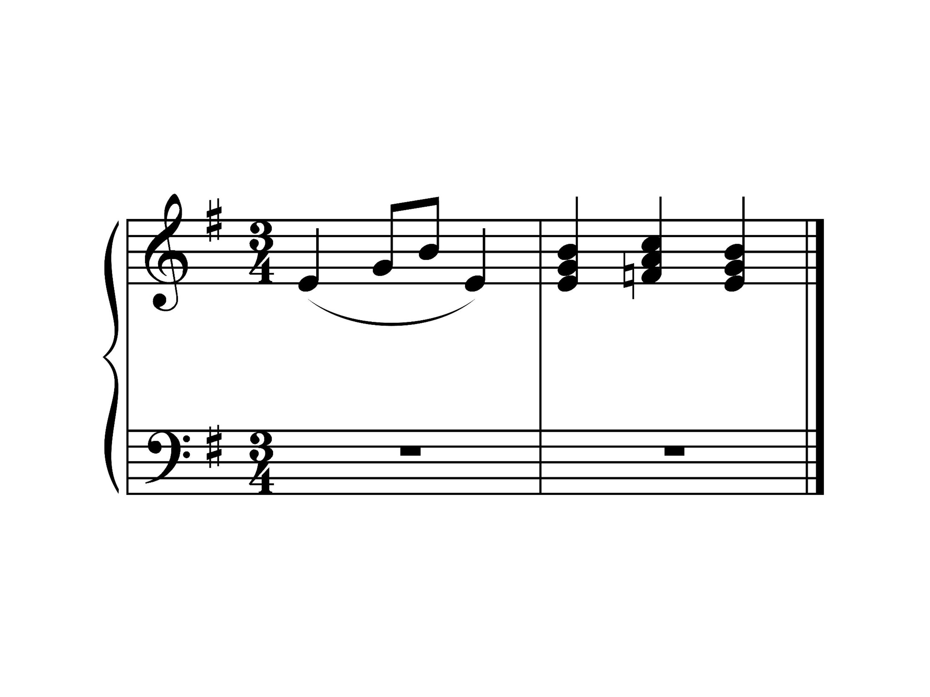
Example 4

Slide 9
Play now.

Slide 10
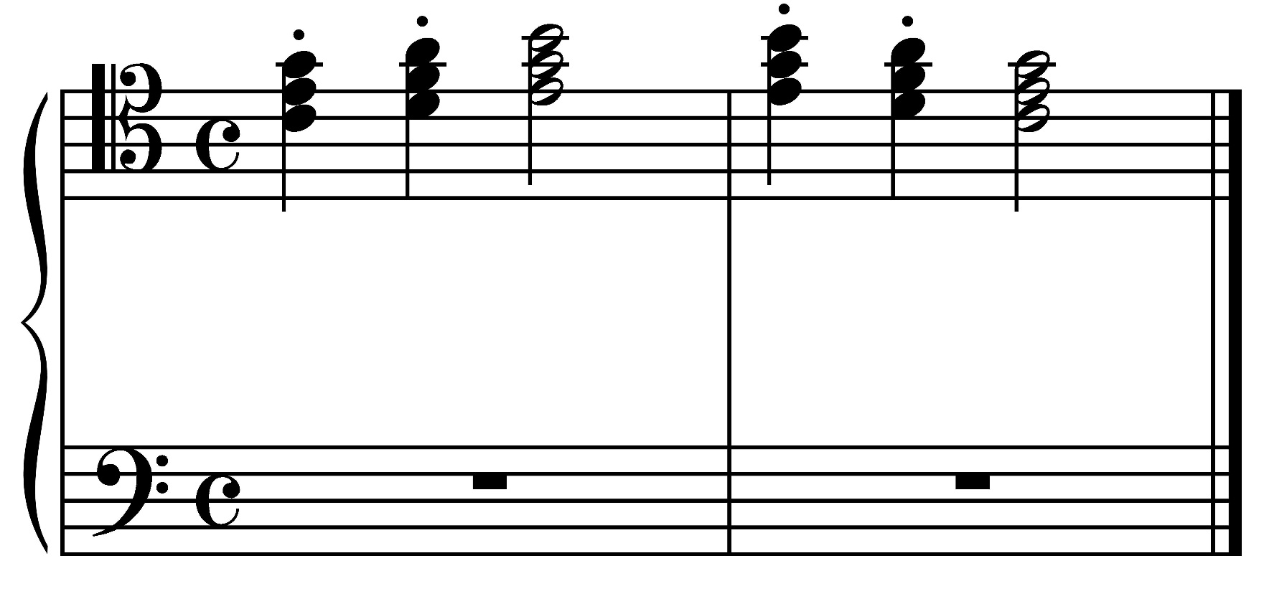
Example 5

Slide 11
Play now.

Slide 12
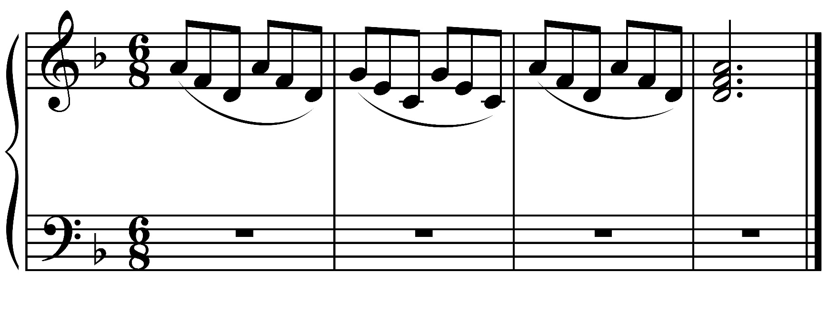
Example 6

Slide 13
Play now.

Slide 14
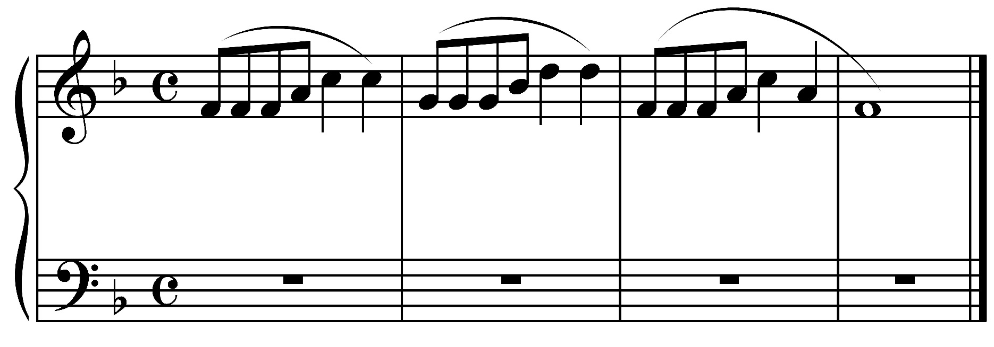
Example 7

Slide 15
Play now.

Slide 16
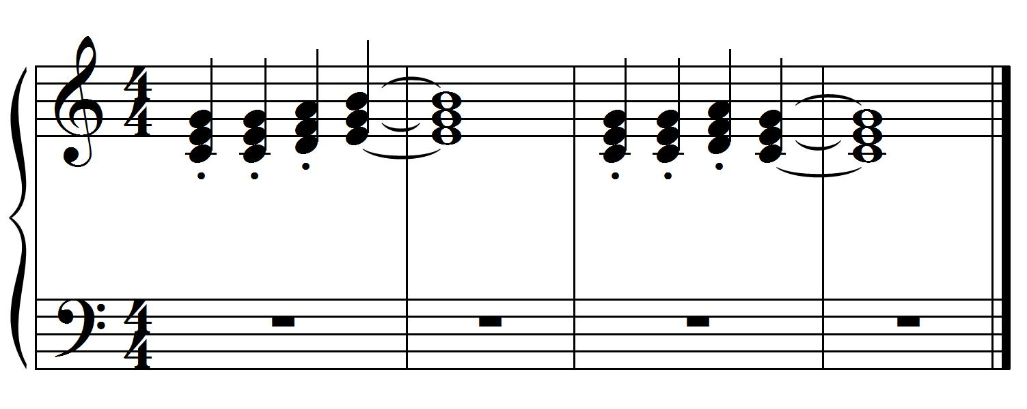
Example 8
Prima Vista Reading

Slide 17
Play now.

Slide 18
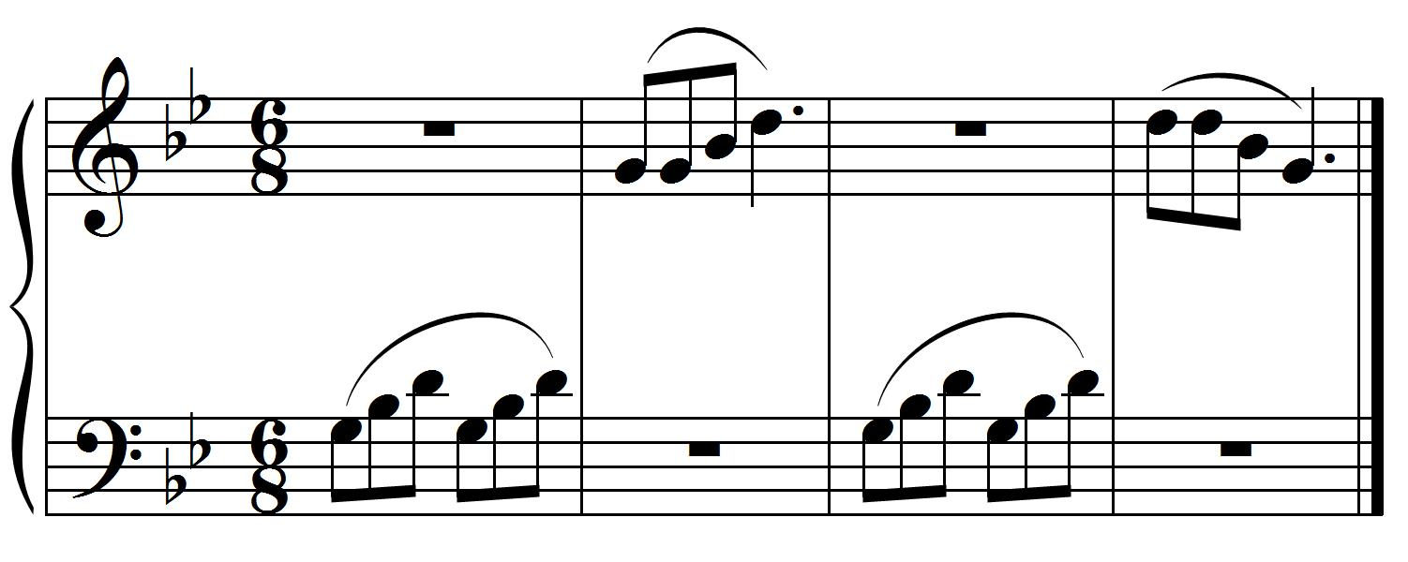
Example 9
Prima Vista Reading

Slide 19
Play now.

Slide 20
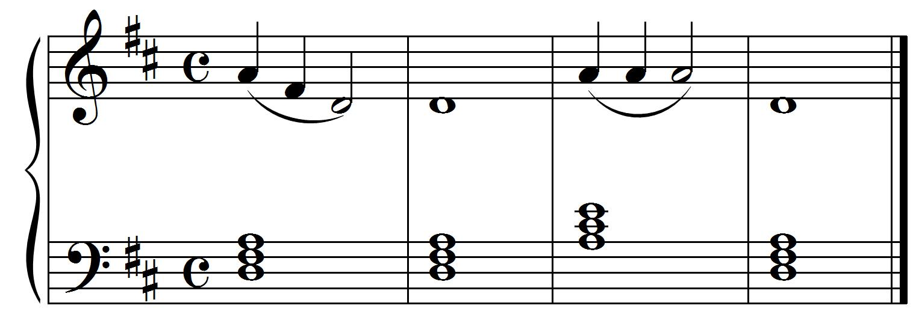
Example 10
Prima Vista Reading

Slide 21
Play now.

Slide 22
© 2017 All Rights Reserved.

